Slide 1
Environmental Justice Considerations in the Colorado River Basin
Zoey Reed-Spitzer
May 22, 2024

Slide 2
Environmental Justice in Colorado River Basin
Environmental burdens in CRB include lack of access to green space, clean air, safe drinking water, & complete household water infrastructure
Important for protecting quality & quantity of water supply & supporting well-being of water users
Environmental burdens impose adverse health outcomes (20, 21, 22, 23, 24, 25, 26)
Investigating whether certain groups disproportionately exposed to burdens

Slide 3
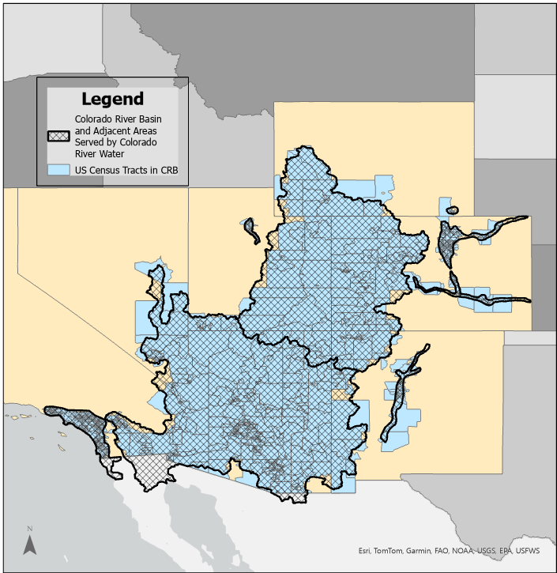

Slide 4
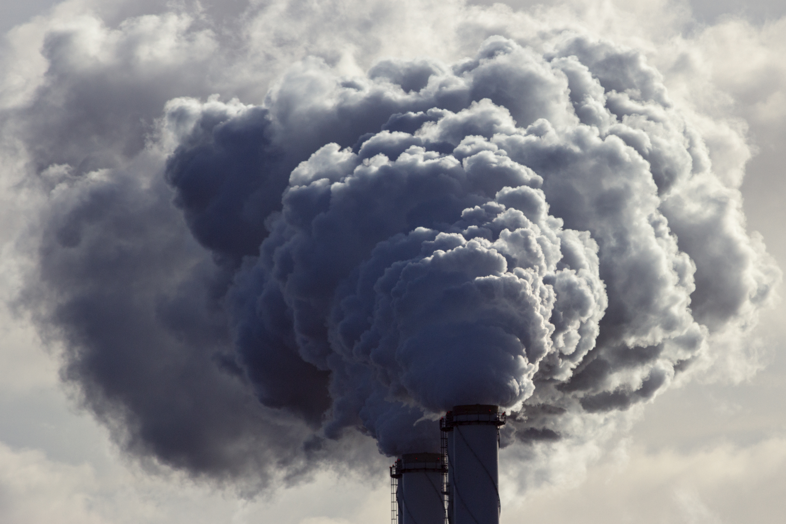

Environmental Justice Literature
Burdens lead to adverse health outcomes hindering productivity & income equality (20, 21, 22, 23; 24, 25, 26, 27)
Mitigation strategies’ disproportional outcomes
Tree canopy and green space less likely to be located in communities with higher minority populations (28, 29)
Tree planting programs → gentrification in NYC (30)

Slide 5
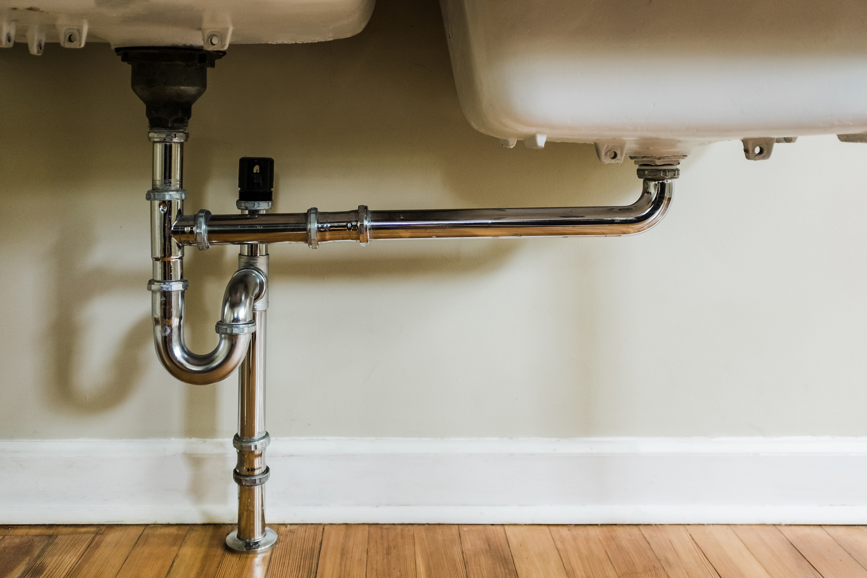

Environmental Justice Literature
Negative impacts of air & water pollution fall more on low-income & racial/ethnic minorities (24, 26, 31, 32, 33)
Poor water infrastructure in cities and households increases vulnerability to natural disasters, exposure to lead, and inhibits full use of water right (34, 35, 36, 37)
This study adds to the literature by utilizing newly released data set by Council on Environmental Quality (CEQ) in 2022
Notes:
Pollution: Much of the studies look at Safe drinking water violations and air pollution prevalence both of which found to occur in areas with higher minority populations.
New CEQ data compliles environmental burdens with race, ethnicity, income, education, & health characteristics

Slide 6
Environmental Burden | Definition | Measurement Units | Years Available in CEJST
Lack of Green Space | Share of census tract acreage that is artificial surface (i.e. cement, roads, etc.), including cropland. | Percent | 2019
Households with Incomplete Plumbing | The percent of households with incomplete kitchens or plumbing. | Percent | 2018
Leaky Underground Storage Tanks (USTs) | The density of leaky USTs and all active USTs within 1500 feet of each census tract. | Density | 2021
PM2.5 in the Air | The amount of inhalable particles, less than 2.5 micrometers, in the air. | Micrograms per cubic meter of air | 2017
Note. Environmental burdens measured at the census tract level
Notes:
##Note: According to the U.S. Census Bureau, households with incomplete plumbing are those that lack at least one of the following characteristics: hot and cold piped water, bathtub or shower, and flushable toilet; whereas households with incomplete kitchens are those that lack a sink with a faucet, stove or gas range, and/or a refrigerator
Can explain error correction for lack of green space here if needed

Slide 7

Variable | Definition | Units
Race & Ethnicity | Race: Number of people who identify as White, Black, American Indian, etc. Ethnicity: Number of people who identify as Hispanic | Count
Income | Mean household income in each census tract | U.S. Dollars
Education | Percent of people aged 25 or older with no high school degree | Percent
Population Density | Population divided by acres in each census tract | Density

Slide 8
ACS Population Breakdown
White
People of Color (Black, Asian, etc.)
Non-Hispanic or Latino
White
Ethnicity
Race
People of Color (Black, Asian, etc.)
Hispanic or Latino
Two Categories:

Slide 10
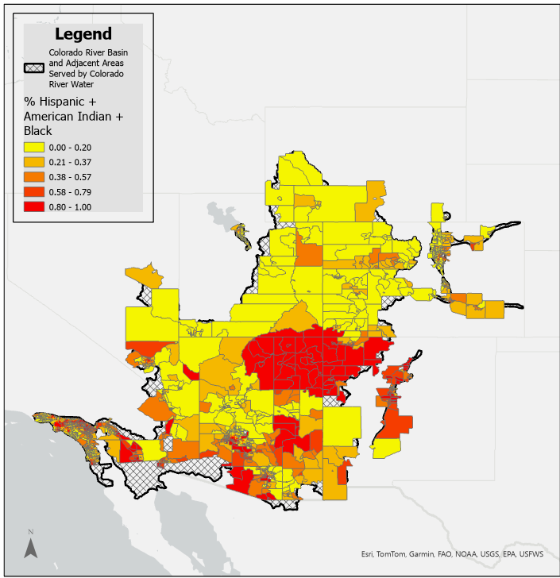
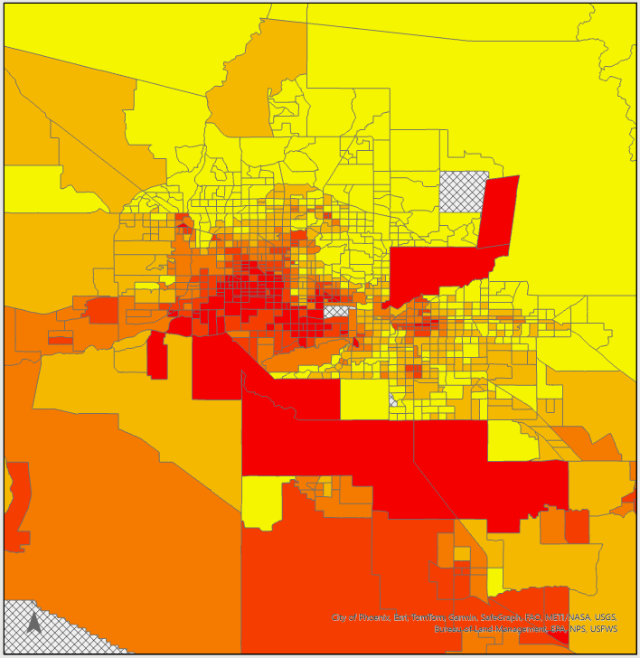
Maricopa County & some of Pinal County in AZ

Slide 11
Limitations in CEJST Data
Spatial mismatches at basin edges
Exclude census tracts with <50% impervious surface or cropland occurring within intersection
Air pollution measurement gaps likely in rural areas (EPA fills measurement gaps with modeling) (41)
Notes:
##Air pollution gaps: rural areas subject to error or underestimation of air pollution measurements
##“To fill in the gaps in those states, state average monthly profiles for oil, natural gas, and combination sources were calculated from Energy Information Administration (EIA) data and assigned to each county/SCC combination not already covered by the OGT monthly temporal profile dataset. Coal bed methane (CBM) and natural gas liquid sources in those four states were assigned flat monthly profiles where there was not already a profile assignment in the ERG dataset.”

Slide 12
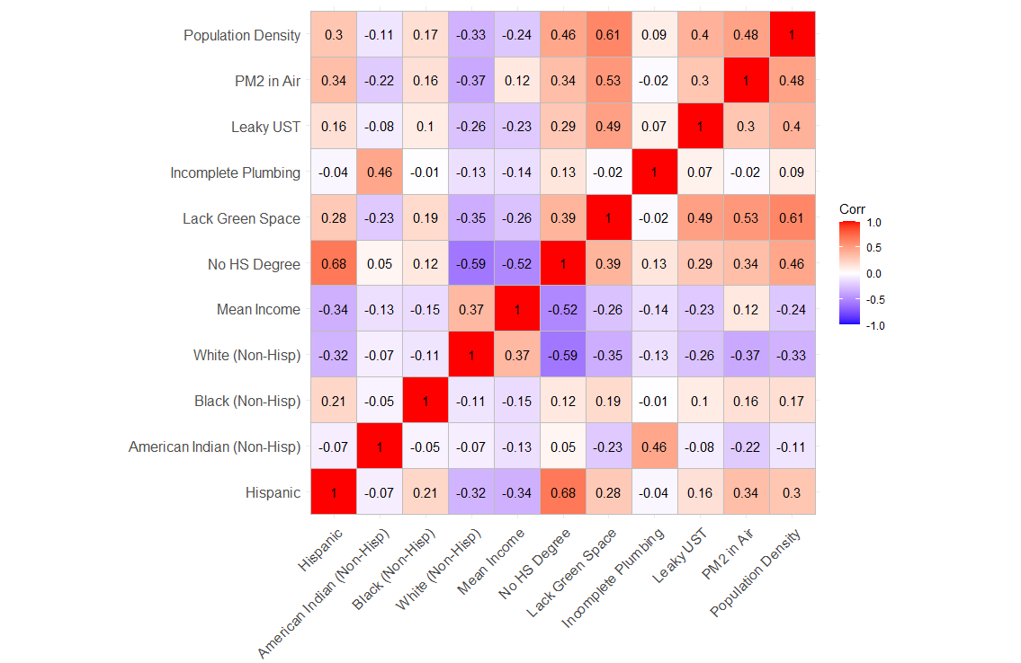
Correlations Between Environmental Burdens and Independent Variables in the CRB
Notes:
##Correlation calculated: covariance / standard deviations of each variable multiplied together.

Slide 13
Summary Statistics
Variable | min | mean | median | max | sd
% Non-green space | 0.03% | 49.49% | 53.02% | 97.30% | 21.78%
% Households with incomplete kitchen/plumbing | 0% | 0.01% | 0% | .62% | 0.03%
Leaky USTs | 0.0 | 3.4 | 2.2 | 42.2 | 4.0
PM2.5 in the air | 4.0 | 9.5 | 9.3 | 13.9 | 2.6
Hispanic (count) | 0.0 | 1727.9 | 1255.0 | 14901.0 | 1532.6
American Indian (count) | 0.0 | 68.3 | 0.0 | 7129.0 | 377.3
Black (count) | 0.0 | 245.7 | 101.0 | 5737.0 | 411.7
% Without highschool degree | 0% | 15.20% | 10% | 75% | 13.97%
Mean Income | $0.00 | $91,406.90 | $81,376.50 | $434,685.00 | $45,269.40
Population | 0.0 | 4,705.2 | 4,424.5 | 38,754.0 | 2211.7
Notes:
##Point out HH w/ incomplete plumbing and pop minimum
##Change green space to percentile

Slide 14
Econometric Models
7,756 observations at census tract level (cross-sectional)
Ordinary Least Squares (OLS) model employed to analyze relationship between each environmental burden & demographics, income, & education
Race & ethnicity found to correlate with income & education (38, 39)
Variance inflation factor (VIF) calculated to ensure variance not overinflated due to collinearity between explanatory variables (40)
State fixed effects included to avoid endogeneity from unobserved heterogeneity between census tracts
Four models analyzed with same explanatory variables & different environmental burden as dependent variable
Two burdens analyzed with subsets of data based on population density
Notes:
State fixed effects: Example) attitudes and preferences towards burdens, political beliefs, & amenities available
Mention subsets based on pop density

Slide 15
Dependent Variable: | Lack Plumbing |  | Leaky UST's |  | PM2.5 in Air |  | Lack Green Space
term | estimate |  | estimate |  | estimate |  | estimate
(Intercept) | 0.0092 | *** | 2.29 | *** | 6.29 | *** | 43.11 | ***
 | 0.00097 |  | 0.14 |  | 0.061 |  | 0.91
Hispanic | -0.0000027 | *** | -0.0003 | *** | 0.0001 | *** | -0.0002
 | 0.0000004 |  | 0.00004 |  | 0.00002 |  | 0.0002
American Indian | 0.00003 | *** | -0.0006 | *** | -0.0004 | *** | -0.0092 | ***
 | 0.000003 |  | 0.0001 |  | 0.00004 |  | 0.0005
Black | 0.00000003 |  | 0.0003 | ** | 0.0004 | *** | 0.0023 | ***
 | 0.00000125 |  | 0.0001 |  | 0.00003 |  | 0.0004
% No High School Degree | 0.00020 | *** | 0.037 | *** | 0.024 | *** | 0.095 | ***
 | 0.00006 |  | 0.006 |  | 0.0017 |  | 0.023
Mean Income (Scaled $10,000) | -0.0000005 | *** | -0.0001 | *** | 0.0001 | *** | -0.0008 | ***
 | 0.0000001 |  | 0.00001 |  | 0.000004 |  | 0.0001
Population Density (Scaled 1000) | 0.166 | *** | 88.07 | *** | 27.77 | *** | 767.51 | ***
 | 0.038 |  | 7.56 |  | 1.87 |  | 37.22
State Controls | Yes |  | Yes |  | Yes |  | Yes
Observations | 7756 |  | 7756 |  | 7756 |  | 7756
R2 | 0.2565 |  | 0.2114 |  | 0.7811 |  | 0.4768
Adj. R2 | 0.2553 |  | 0.2102 |  | 0.7808 |  | 0.476
F Statistic (12;df=7743) | 222.6 | *** | 173 | *** | 2302 | *** | 588 | ***
Notes:
##Mention VIF under 3 and robust standard errors due to heteroskedasticity (residual variance is not constant)
#changed census tracts to stricter requirements (human activity <50 percent excluded) and Green space error assumed and decimal point inserted…
*presenting these May 22

Slide 16
Lack Green Space | Pop. Dens. below 40 (Rural) |  | Pop. Dens. above 50
term | estimate |  | estimate
(Intercept) | 46.70 | *** | 91.35 | ***
 | 0.98 |  | 3.22
Hispanic | -0.0006 | *** | -0.0023 | ***
 | 0.0002 |  | 0.0006
American Indian | -0.011 | *** | 0.047
 | 0.001 |  | 0.032
Black | 0.0041 | *** | 0.0012
 | 0.0004 |  | 0.0012
% No High School Degree | 0.33 | *** | 0.066
 | 0.024 |  | 0.052
Mean Income (Scaled $10,000) | -0.0010 | *** | -0.0012 | ***
 | 0.0001 |  | 0.0004
State Controls | Yes |  | Yes
Observations | 7479 |  | 134
R2 | 0.3136 |  | 0.2248
Adj. R2 | 0.3126 |  | 0.1882
F Statistic (12;df=7743) | (11;df=7467) | (6;df=127) | (7;df=126) | 310.1 | *** | 6.138 | ***

Slide 17
PM2.5 in Air | Pop. Dens. below 40 (Rural) |  | Pop. Dens. above 50
term | estimate |  | estimate
(Intercept) | 6.41 | *** | 11.80 | ***
 | 0.060 |  | 0.40
Hispanic | 0.00005 | *** | -0.0002 | **
 | 0.00002 |  | 0.0001
American Indian | -0.0005 | *** | 0.0085 | **
 | 0.00005 |  | 0.0040
Black | 0.0005 | *** | 0.0003 | **
 | 0.00003 |  | 0.0001
% No High School Degree | 0.033 | *** | 0.022 | ***
 | 0.0018 |  | 0.0064
Mean Income (Scaled $10,000) | 0.0001 | *** | 0.00002
 | 0.000004 |  | 0.00005
State Controls | Yes |  | Yes
Observations | 7479 |  | 134
R2 | 0.7628 |  | 0.3477
Adj. R2 | 0.7624 |  | 0.3169
F Statistic (12;df=7743) | (11;df=7467) | (6;df=127) | (7;df=126) | 2183 | *** | 11.28 | ***

Slide 18
Summary of Statistical Findings
Racial and ethnic minorities more likely to live in areas with higher environmental burden prevalence
Higher income communities experience less environmental burden, but air pollution pervasive
Lower educated individuals more likely to live in communities with higher prevalence of each burden
More densely populated areas have higher environmental burden prevalence

Slide 19

Policy Implications
Environmental policies targeting denser areas may be useful
Policies targeted towards low-income, less educated communities needed to lessen disproportional environmental burdens
Emphasizing ways to limit potential gentrification effects
Notes:
Begin: We’ve been aiming to Understand which groups are likely vulnerable to the four environmental burdens examined can help inform policy regarding where to target water allocations, air pollution mitigation strategies, and investments in water quality and household infrastructure.
Second: Results align with past literature looking at disproportional outcomes on minority groups or people with lower income and less educated
Targeting cities: as places with higher population density are also places with higher env burden prevalence

Slide 20
Conclusion
Further policy may be needed in CRB to address disproportional environmental burden on disadvantaged communities
While efforts are being made to lessen environmental burdens, more work towards equitable outcomes is needed
Notes:
More equitable outcomes… regardless of race and ethnicity or income and education level

Slide 21

Thank you

Slide 22
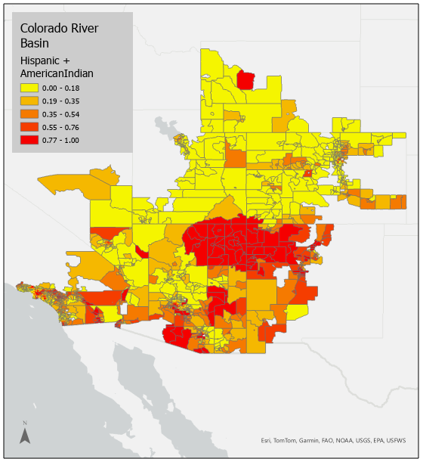

Slide 23
Dependent Variable: | Incomplete Plumbing
 | (1) |  | (2) No Pop |  | (3) No HS |  | (4)
Variable | estimate |  | estimate |  | estimate |  | estimate
(Intercept) | 0.01433 | *** | 0.01029 | *** | 0.0121 | *** | 0.0093 | ***
 | 0.00116 |  | 0.00094 |  | 0.0012 |  | 0.0010
Hispanic | -0.000002 | *** | -0.000003 | *** | -0.0000019 | *** | -0.000003 | ***
 | 0.000000 |  | 0.000000 |  | 0.0000002 |  | 0.000000
American Indian (Non-Hisp) | 0.000032 | *** | 0.000031 | *** | 0.0000326 | *** | 0.000032 | ***
 | 0.000003 |  | 0.000003 |  | 0.0000034 |  | 0.000003
Black (Non-Hisp) | -0.0000002 |  | 0.0000004 |  | -0.0000006 |  | 0.000000005
 | 0.000001 |  | 0.0000013 |  | 0.0000012 |  | 0.00000124
Mean Income (scaled $10,000) | -0.000001 | *** | -0.0000005 | *** | -0.0000007 | *** | -0.0000005 | ***
 | 0.000000 |  | 0.000000 |  | 0.0000001 |  | 0.0000001
% No HS Degree |  |  | 0.00027 | *** |  |  | 0.0002 | ***
 |  |  | 0.00006 |  |  |  | 0.0001
Population Density (scaled 1000) |  |  |  |  | 0.2081 | *** | 0.1602 | ***
 |  |  |  |  | 0.0332 |  | 0.0373
State Effects | Yes |  | Yes |  | Yes |  | Yes
Observations | 7939 |  | 7939 |  | 7939 |  | 7939
R2 | 0.2492 |  | 0.2576 |  | 0.2567 |  | 0.2617
Adj. R2 | 0.2482 |  | 0.2566 |  | 0.2557 |  | 0.2606
F Stat (10; df=7928) | (11; df=7927) | (12; df=7926) | 263.1 | *** | 250 | *** | 248.9 | *** | 234.2 | ***

Slide 24
Dependent Variable: | Leaky UST
 | (1) |  | (2) No Pop |  | (3) No HS |  | (4)
Variable | estimate |  | estimate |  | estimate |  | estimate
(Intercept) | 3.74 | *** | 2.74 | *** | 2.66 | *** | 2.21 | ***
 | 0.14 |  | 0.14 |  | 0.14 |  | 0.14
Hispanic | -0.00001 |  | -0.0003 | *** | -0.00008 | ** | -0.0002 | ***
 | 0.00003 |  | 0.0000 |  | 0.00003 |  | 0.0000
American Indian (Non-Hisp) | -0.00063 | *** | -0.0008 | *** | -0.00044 | *** | -0.0006 | ***
 | 0.00008 |  | 0.0001 |  | 0.00007 |  | 0.0001
Black (Non-Hisp) | 0.00039 | *** | 0.0006 | *** | 0.00020 | ** | 0.0003 | **
 | 0.00012 |  | 0.0001 |  | 0.00012 |  | 0.0001
Mean Income (scaled $10,000) | -0.00024 | *** | -0.0002 | *** | -0.00016 | *** | -0.0001 | ***
 | 0.00001 |  | 0.0000 |  | 0.00001 |  | 0.0000
% No HS Degree |  |  | 0.066 | *** |  |  | 0.0359 | ***
 |  |  | 0.006 |  |  |  | 0.0058
Population Density (scaled 1000) |  |  |  |  | 99.26 | *** | 91.27 | ***
 |  |  |  |  | 7.31 |  | 7.54
State Effects | Yes |  | Yes |  | Yes |  | Yes
Observations | 7939 |  | 7939 |  | 7939 |  | 7939
R2 | 0.1346 |  | 0.1564 |  | 0.2079 |  | 0.2138
Adj. R2 | 0.1335 |  | 0.1553 |  | 0.2068 |  | 0.2126
F Stat (10; df=7928) | (11; df=7927) | (12; df=7926) | 123.3 | *** | 133.6 | *** | 189.1 | *** | 179.6 | ***

Slide 25
Dependent Variable: | PM2.5 In Air
 | (1) |  | (2) No Pop |  | (3) No HS |  | (4)
Variable | estimate |  | estimate |  | estimate |  | estimate
(Intercept) | 6.93 | *** | 6.429493 | *** | 6.55 | *** | 6.252 | ***
 | 0.06 |  | 0.0585904 |  | 0.06 |  | 0.061
Hispanic | 0.00020 | *** | 0.00004 | ** | 0.00018 | *** | 0.00007 | ***
 | 0.00001 |  | 0.00002 |  | 0.00001 |  | 0.00002
American Indian (Non-Hisp) | -0.00042 | *** | -0.00052 | *** | -0.00035 | *** | -0.00043 | ***
 | 0.00004 |  | 0.00004 |  | 0.00004 |  | 0.00004
Black (Non-Hisp) | 0.00045 | *** | 0.00053 | *** | 0.00038 | *** | 0.00045 | ***
 | 0.00003 |  | 0.00003 |  | 0.00003 |  | 0.00003
Mean Income (scaled $10,000) | 0.00001 | *** | 0.00005 | *** | 0.00004 | *** | 0.00006 | ***
 | 0.00000 |  | 0.000004 |  | 0.000004 |  | 0.00000
% No HS Degree |  |  | 0.033342 | *** |  |  | 0.02330 | ***
 |  |  | 0.0016585 |  |  |  | 0.00173
Population Density (scaled 1000) |  |  |  |  | 35.20392 | *** | 30.02 | ***
 |  |  |  |  | 2.00120 |  | 1.94
State Effects | Yes |  | Yes |  | Yes |  | Yes
Observations | 7939 |  | 7939 |  | 7939 |  | 7939
R2 | 0.7556 |  | 0.7677 |  | 0.7759 |  | 0.7814
Adj. R2 | 0.7553 |  | 0.7674 |  | 0.7756 |  | 0.781
F Stat (10; df=7928) | (11; df=7927) | (12; df=7926) | 2451 | *** | 2381 | *** | 2495 | *** | 2360 | ***

Slide 26
Summary Statistics (pop subset <40)
Variable | min | mean | median | max | sd
% Non-green space | 0.03% | 48.37% | 52.18% | 97.29% | 21.33%
% Households with incomplete kitchen/plumbing | 0% | 0.01% | 0% | 0.62% | 0.02%
Leaky USTs | 0.0 | 3.3 | 2.2 | 36.6 | 3.7
PM2.5 in the air | 4.0 | 9.4 | 9.1 | 13.9 | 2.6
Hispanic (count) | 0.0 | 1698.5 | 1225.0 | 14901.0 | 1525.1
American Indian (count) | 0.0 | 70.4 | 1.0 | 7129.0 | 384.1
Black (count) | 0.0 | 241.5 | 99.0 | 5737.0 | 406.8
% Without highschool degree | 0% | 14.55% | 10% | 75% | 13.32%
Mean Income | 0.0 | 92610.1 | 82734.0 | 434685.0 | 45506.9
Population | 0.0 | 4719.4 | 4437.0 | 38754.0 | 2237.0

Slide 27
Summary Statistics (Pop subset >50)
Variable | min | mean | median | max | sd
% Non-green space | 56.17% | 82.27% | 83.25% | 92.83% | 6.25%
% Households with incomplete kitchen/plumbing | 0% | 0.02% | 0.02% | 0.20% | 0.03%
Leaky USTs | 0.0 | 9.0 | 8.4 | 42.2 | 7.5
PM2.5 in the air | 7.6 | 12.3 | 12.6 | 13.5 | 0.8
Hispanic (count) | 172.0 | 2350.5 | 2198.5 | 7164.0 | 1375.5
American Indian (count) | 0.0 | 6.4 | 0.0 | 106.0 | 15.5
Black (count) | 0.0 | 318.1 | 163.5 | 2901.0 | 439.3
% Without highschool degree | 0% | 32.05% | 32% | 72% | 19.22%
Mean Income | 31596.0 | 55827.1 | 52717.5 | 129397.0 | 16480.3
Population | 1940.0 | 4151.4 | 4108.0 | 7995.0 | 1135.6

Slide 28
Future Research Directions
As remote sensing products continue to become available
Explore relationships with environmental burdens & demographics over time with panel data
Because there are gaps between air pollution monitoring stations, further analysis of air pollution still needs to be explored at a more local level by accounting for point sources in rural areas (41)
Exploring relationships between environmental burdens & Hispanic split between white and non-white interesting to see if race alone is a larger driver for disproportional exposure
Notes:
Income & DTW relationship: people with more options for how they use GW can choose to do more or less with water (invest in pool or water efficient landscaping/newer appliances)

